Slide 1
Update on the ACA
September 2014
Leland E. Garrett MD FACP FASN CPC
Medical Director Blue Cross Blue Shield of North Carolina
Clinical Professor of Medicine
University of North Carolina School of Medicine

Slide 2


The Players

Slide 3
The Most Important Player
YOU

Slide 4
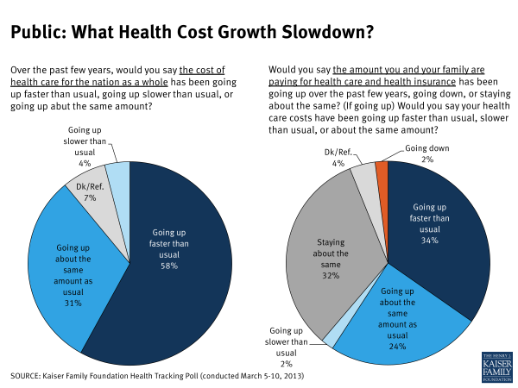

Slide 5
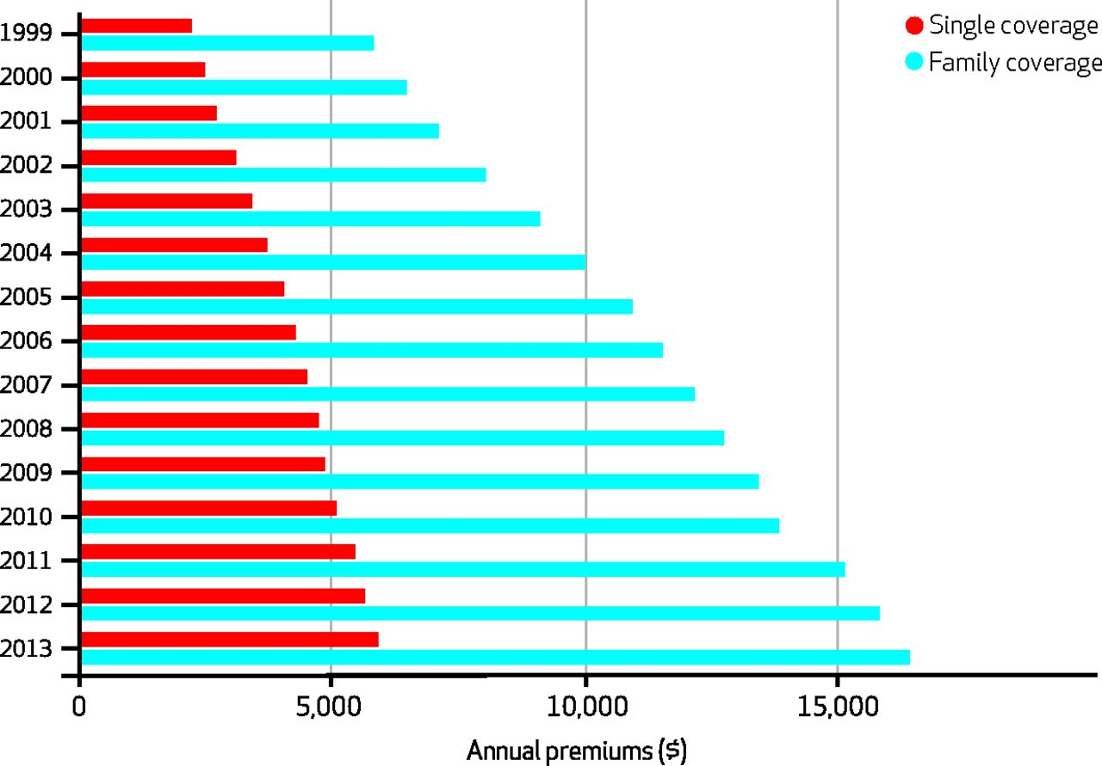

Average Annual Premiums For Single And Family Coverage, 1999–2013.
Claxton G et al. Health Aff 2013;32:1667-1676
©2013 by Project HOPE - The People-to-People Health Foundation, Inc.
Notes:
Average Annual Premiums For Single And Family Coverage, 1999–2013

Slide 6
Second Most Important
EMPLOYERS

Slide 7
Employers
Want to provide their employees the best available care at the lowest cost.
Have direct influence on how the care is delivered
Have a direct influence on the cost of that care

Slide 8
The 300 pound gorilla
THE FEDERAL and STATE
GOVERNMENTS

Slide 9
Governments
Dictate the Rules
Insures almost half of the population
Golden Rule
  “He who has the money makes the rules”

Slide 10
IN THE MIDDLE
INSURANCE

Slide 11
Insurance defined (Wikipedia)
Insurance is a form of risk management primarily used to hedge against the risk of a contingent, uncertain loss.
Insurance is defined as the equitable transfer of the risk of a loss, from one entity to another, in exchange for payment.
Notes:
In today’s world, the traditional definition of insurance most closely describes catastrophic health insurance. The term more properly assigned to “Health insurance” is “Health Plan” since the Plan covers known (and needed) preventive care services, actually works to stimulate utilization of appropriate services (e.g. care gap closure), and sets coverage guidelines for the [medical] necessity of services.

Slide 12
What “insurance” covers and why
Benefits
  mandates
  “essential benefits”
  “medical necessity”
  price point
  customer preference
Medical necessity
  Services for diagnosis, treatment of a health condition
  Necessary and appropriate
  Generally accepted standard of the medical community
  Not solely for convenience
  Cost-effectiveness considered

Slide 13


PHOTO of HQ from Kyle
Blue Cross and Blue Shield of North Carolina
North Carolina’s largest health insurer
3.8 million members
26,000 in-network providers
4,500 employees
$6.4 billion revenue (2013)
Founded in 1933

Slide 14
Blue Cross and Blue Shield of North Carolina
(BCBSNC)
Not-for-profit, fully taxed
Single state health plan, one of 39 BCBS plans nationally
3.8 million members in North Carolina
Covers one third of all NC residents, about half of insured
Largest and oldest health insurer in North Carolina
Sixth largest insurer of individuals in the US
Only insurer in the state with availability of exchange insurance in all counties of North Carolina
Notes:
Wellpoint, which includes 14 Blues Plans, is the only for-profit Blue.

Slide 15
Medicare and Medicaid
Both established 1965
Medicare
  Federally administered and funded
  Eligibility: all 65 yo and older, some disabled under 65 yo
  No means testing
  Part D (drug coverage) 2006
  Recently passed the 100 million mark in covered lives
Medicaid
  State administered and jointly funded by feds and state
  Eligibility: means-tested, low income adults with children and/or pregnant, certain disabilities, low income, low asset nursing home patients
  US citizen or legal immigrants only
  CHIP 1997- broader coverage for children
Notes:
Basic facts about Medicare and Medicaid. Many providers do not understand that Medicaid does not cover all poor people, and that states help fund and have a good deal of lead way in how Medicaid programs are administered.

Slide 16
The Problem

Slide 17
Components of Health Care Quality
Institute of Medicine (IOM)
Safety
Effectiveness
Patient Centeredness
Timeliness
Efficiency
Equity

Slide 18
Institute for Healthcare Improvement Triple Aim
Improving the patient experience of care (including quality and satisfaction);
Improving the health of populations
Reducing the per capita cost of health care

Slide 19
Definitions and Components of Health Care Quality
Institute of Medicine (IOM)
Quality is “the degree to which health services for individuals and populations increases the likelihood of desired health outcomes and are consistent with current professional knowledge.”

Slide 20
Quality-Cost Relationship- 2007
Data Shows That Medicare Providers Differ in the Quality and Efficiency of Care They Deliver
High quality/High efficiency
Lower quality/Lower efficiency
CMS, 2007

Slide 21
Impact of inadequate medical care
Avoidable death and medical costs due
to unexplained variations in care:
Selected measures and conditions in U.S. population
Measure | Avoidable deaths | Avoidable medical costs
Controlling high blood pressure | 12,000 – 32,000 | $382 million – $1 billion
Cholesterol management (control) | 3,400 – 7,200 | $70 million – $88 million
Diabetes care – HbA1c control | 5,300 – 11,700 | $693 million – $1.2 billion
Smoking cessation | 8,300 – 13,200 | $859 million – $1 billion
Prenatal care | 1,000 – 1,750 | $519 million – $524 million
Colorectal cancer screening | 4,100 – 6,200 | $188 million – $194 million
Total | 34,100 – 72,050 | $2.7 billion – $4.1 billion
Source: The National Committee for Quality Assurance, The State of Heal Care Quality, 2005, p. 10 http://www.ncqa.org/Communications/News/SOHC_2005.htm.

Slide 22
BUT:
“Drugs don’t work in patients who don’t take them.” – C Everett Koop MD
Medication non-adherence results in more deaths in the U.S. per year than:
  Deaths related to alcohol abuse
  Deaths from illicit drug use
  Deaths caused by adverse reactions to prescription medications

Slide 23
True Cost of Medication Non-adherence
Every year, medication non-adherence in the United States results in enormous costs to the healthcare system
  89,000-125,000 premature deaths
  33-69% of medication-related hospital admissions
  An additional $2,000 per patient in medical costs and physician visits
  $290 billion in direct and indirect healthcare costs
Cutler DM, Everett W. Thinking outside the pillbox – medication adherence as a priority for health care reform. N Engl J Med. 2010;362:1553-55. Mortality statistics provided by Centers for Disease Control (CDC).
Notes:
Implications of nonadherence:
Health implications are severe
For patients
Faster progression of diseases
Reduced functional abilities
Lower quality of life
Premature death
For public health
Increased doctor’s office visits
Increased hospitalizations
Increased nursing home admissions
Reference: National Council on Patient Information and Education (NCPIE). Enhancing Prescription Medicine Adherence: A National Action Plan. August 2007.

Slide 24
The Need

Slide 25

Health Insurance Coverage in the U.S., 2010
Total = 305.2 million
* Medicaid also includes other public programs: CHIP, other state programs, military-related coverage. Numbers may not add to 100 due to rounding.
SOURCE: KCMU/Urban Institute analysis of 2011 ASEC Supplement to the CPS.
Notes:
The proportion of employer-based insurance has been decreasing over the last decade, and will likely continue that trend under the Affordable Care Act. Small group employers and perhaps some large employers may provide a defined dollar amount for benefits and “dump” employees into the healthcare exchange market. Although they will pay a penalty to the government, it will be less than their expense to continue providing health insurance, and will be far more predictable for budgeting.
With the Supreme Court determining that state participation in Medicaid expansion is optional and “with fourteen states opting out, we [Rand] estimate that 3.6 million fewer people would be insured, federal transfer payments to those states could fall by $8.4 billion, and state spending on uncompensated care could increase by $1 billion in 2016, compared to what would be expected if all states participated in the expansion.” (Health Aff June 2013 32:61030-1036)

Slide 26
Uninsured Rates Among Nonelderly
by State, 2009-2010
NH
WA
VT
ME
MT
ND
OR
MN
MA
SD
WI
NY
ID
MI
RI
WY
PA
CT
NE
IA
NJ
NV
IL
IN
OH
DE
UT
CO
WV
VA
MD
CA
KS
MO
KY
NC
DC
OK
TN
SC
AZ
NM
AR
MS
AL
GA
AK
TX
LA
FL
HI
<14% Uninsured (13 states & DC)
National Average = 18.4%
14 to 18% Uninsured (18 states)
>18% Uninsured (19 states)
SOURCE: KCMU/Urban Institute analysis of 2010 and 2011 ASEC Supplement to the CPS (two-year pooled data). In 2011, the Census Bureau adjusted the imputation methodology for variables related to insurance coverage but has not yet released detailed revised data for previous years. This map applies methodology to replicate the Census’s revision.

Slide 27
Characteristics of the Nonelderly Uninsured, 2010
Family Status
Family Income
Family Work Status
400% FPL
and Above
251-399%
FPL
No Workers
Children
Adults without Dependent Children
<100% FPL
1 or More Full-Time Workers
Parents
100-250% FPL
Part-Time Workers
Total = 49.1 million uninsured
The federal poverty level was $22,050 for a family of four in 2010.
Data may not total 100% due to rounding.
SOURCE: KCMU/Urban Institute analysis of 2011 ASEC Supplement to the CPS.

Slide 28
The Solution?

Slide 29

Health Reform is Complex
Issues overlap
  Reforms don’t address just one issue
  Reforms work together to achieve the larger goal: more affordable and accessible health care coverage for everyone

Slide 30

In a nutshell
The Affordable Care Act (ACA):
Mandates coverage
Mandates insurance reform
Fundamentally changes how insurance is purchased
  Health Insurance Marketplaces/Exchanges
  Think: Expedia for health insurance

Slide 31
Mandates
Individual
  Must carry minimum essential coverage or pay an annual fine on their taxes
  MEC: government coverage; employer coverage; individual plan; grandfathered/transitional coverage; etc
  Fine is greater of $95 or 1% income, whichever is greater
Employer
  Small employers (50 or fewer full-timers): will not be fined if they do not offer coverage; must include essential health benefits package
  Large employers (51 or more full-timers): will be fined if they do not offer coverage that meets certain requirements; do not have to include essential health benefits package
    Phased approach: 100+ must offer in 2015; 51+ in 2016

Slide 32

Implementation Continues …
Small business tax credit
Early retiree reinsurance program
Pre-existing condition insurance plans
Young adults up to age 26 on parents’ plan
Prohibitions against lifetime benefit caps and rescissions No pre-existing exclusions for children
Preventive services coverage without cost-sharing Phased-in ban on annual limits
States adopt exchange legislation, implementation exchanges (2011-2013)
Annual review of premium increases
Public reporting by insurers on share of premiums spent on medical costs
Insurers must spend at least 85% of premiums (large group) or 80% (small group/individual) on
medical costs or provide rebates to enrollees
Exchanges begin certifying Qualified Health Plans
HHS certifies exchanges
Exchange open enrollment begins
Medicaid Expansion as determined by State
Insurance market reforms including no rating on health
Essential benefits standard
Premium and cost-sharing credits for exchange plans
Premium increases a criterion for carrier exchange participation
Individual requirements to have insurance
Employer shared responsibility payments
Option for state waiver to design alternative coverage programs
Source: NAIC

Slide 33
Affordable Care Act Time Line
2010
  Extended coverage for young adults up to 26 y.o.
  High risk insurance pool (temporary)
  Web site with insurance options
  Reinsurance for covering early retirees (closed 12/2011) $4.5 billion
  Eliminated Pre-existing Condition exclusions for children
  Covered preventative health services
  Prohibited Rescissions of care
  Prohibited annual and lifetime limits (phased in fully effective 2014)
  Modified/improved appeals process
  Closed the part D donut hole (phase in complete in 2020)
  Small business tax credit begun (increase when exchanges opened)

Slide 34
Affordable Care Act Time Line
2011
  Customer rebates for excessive medical loss ratios
  Definition of Qualified Medical expenses
  Cafeteria plans for small businesses
  Increased taxes on HSA and MSA non-medical withdrawals to 20%
2012
  Preventative Care for Women (contraceptives)
  Uniform Benefit and Coverage summary (easy language; 4 page limit)
  Health care coverage costs reported on W2

Slide 35
Affordable Care Act Time Line
2013
  Administrative simplification (uniform rules for standards and business rules for the exchanges
  Limit FSA contributions to $2500
  Increase threshold for claiming medical expense deductions from 7.5% to 10%
  Coverage of Clinical trial participants
  Comprehensive benefit package
  Increases Employee wellness Incentives available from 20% to 50%
  Heath care tax credits
  Small business tax credit
  Health insurance provider fee (allocated according to market share)
  Hospital Insurance tax for high wage workers
    0.9% for wages over $200,000 ($250,000 married
    3.8% tax on investment income for individuals with income as above
2013 OCTOBER EXCHANGES OPEN
  Multiple exemptions and delays

Slide 36
Affordable Care Act Time Line
2014
  Coverage Mandates in effect (approved by Supreme Court 2011)
    Penalties $95 2014; $325 2015; $695 2016; or up to 2.5% of income
  Waiting periods for employee coverage limited to 90 days
  Guaranteed issue and renewability
  No preexisting exclusions
  Premium risk indexing only for age, geography, family size and tobacco
2015:
  Employer Coverage Mandates in effect 50 or more employees, transition relief applies
  Employer Mandate Penalty:
    If no coverage offered, must pay penalty of $2000/employee after first 30 employees (calc varies in 2015 for transition relief)
    If coverage offered but employees qualify for tax credits, must pay penalty- lesser of $3000 per employee for each worker receiving credit or $2000 per employee
2018
  Cadillac tax

Slide 37
Cadillac Tax
Applies to employer-sponsored insurance
40 percent tax on the dollar amount of premiums over a threshold for individual or family coverage (value includes employer/employee contributions)
Premium amounts are calculated from the employer portion, the employee portion and any funds put into a savings account.
Threshold:
  $10,200 for individuals
  $27,500 for family coverage but
  Adjusted upward if premium growth of >55% in federal employee plan

Slide 38
BCBSNC’s Premium Dollar
Illustrative: Based on GAAP income statement
Notes:
In 2012, closer to $.87 on the dollar was spent on medical costs. The key driver of insurance premiums is medical cost.

Slide 39
Grandfathered vs. Transitional Plans
Grandfathered: if individual had same coverage since March 23, 2010 and NO CHANGES have been made
  Exempt from most (but not all) benefit changes required by ACA
  Still have to remove lifetime limits, no rescissions, and allow children up to age 26 on parents’ plan
Transitional: if individual had coverage on October 1, 2013
  Exempt from some benefit changes required by ACA
  Some ACA changes staged and already implemented by Oct 2013 (like preventive services)
  Still had to remove lifetime and annual limits, include mental health parity

Slide 40
Insurance Changes
Rating
  May only rate for family size, tobacco use, geographic region, and age
  May no longer rate for gender, health status
Benefits
  Must include essential health benefits in all new individual and small group plans
  Must meet certain cost-sharing and out-of-pocket limitations
Marketplace
  Online tool to shop and compare coverage
  Financial assistance available to some for new individual plans only on the Marketplace

Slide 41
Essential Health Benefits
All non-grandfathered, insured small group and individual plans must cover.
State specific benchmark plan (BCBSNC Blue Options PPO).
10 categories of service including:
  Maternity and newborn care
  Rehabilitative and Habilitative
  Pediatric services (includes dental and vision)
Not offered as standard option for large group.

Slide 42

Marketplace
Shop and Compare
Standard metal levels (representing richness)
  Bronze, silver, gold, platinum
  Catastrophic
Purchase and receive subsidized insurance

Slide 43

The Exchange: BCBSNC 2014 Product Offerings
Identical benefit designs
Easy comparison shopping
 | Blue Advantage FULL Network | Blue Value LIMITED Network | Blue Select TIERED Network
Traditional copay coverage type
High deductible coverage type
Hybrid coverage type
U30 catastrophic coverage type
HSA eligible
HSA eligible

Slide 44
Grace Periods
ACA provides for a 90-day grace period for enrollees receiving APTCs
Grace period applies to enrollees who have already paid their share of one month’s premium in full
Grace period triggers once an enrollee subsequently misses a premium payment
Claims must be paid during the first month of the grace period
Claims may be pended during the second and third month of the grace period
State law governs grace periods for enrollees not receiving APTCs within the Exchange
Notes:
3 month grace period must be observed for enrollees receiving APTC’s
if enrollee makes all outstanding premium payments before end of grace period , enrollees enrollment with same QHP remains intact.
If enrollee exhausts grace period without making all outstanding premium payments, issuer must terminate coverage with notice to enrollee.
Enrollee cannot extend the grace period by paying only a portion of outstanding premium.
If terminated, last day of coverage may be the last day of first month of grace period; (may be terminated retroactively).
QHP issuer must return APTCs for 2nd and 3rd month to Treasury Dept.
Enrollee cannot enroll in another QHP with any issuer through special enrollment period. If terminated, all individuals on policy also lose coverage.
Certain notice requirements for enrollees and notice of pending claims to providers
Medical claims will be pended during 2nd and 3rd months
Pharmacy point of sale claims will be denied because they cannot be pended

Slide 45
Grace Periods (2)
3 month grace period must be observed for enrollees receiving APTC’s
if enrollee makes all outstanding premium payments before end of grace period , enrollees enrollment with same QHP remains intact.
If enrollee exhausts grace period without making all outstanding premium payments, issuer must terminate coverage with notice to enrollee.
Enrollee cannot extend the grace period by paying only a portion of outstanding premium.
If terminated, last day of coverage may be the last day of first month of grace period; (may be terminated retroactively).

Slide 46
Grace Periods (3)
QHP issuer must return APTCs for 2nd and 3rd month to Treasury Dept.
Enrollee cannot enroll in another QHP with any issuer through special enrollment period. If terminated, all individuals on policy also lose coverage.
Certain notice requirements for enrollees and notice of pending claims to providers
Medical claims will be pended during 2nd and 3rd months
Pharmacy point of sale claims will be denied because they cannot be pended

Slide 47
Subsidies: Two Kinds
Premium Tax Credit
  A refundable or advanceable tax credit to subsidize the cost of a health insurance premium.
2. Cost-Sharing Reductions
  Available to raise the actuarial value of a plan.
Eligibility Requirements
US citizen or legal alien
Not incarcerated
Resident of state in which exchange is based
Between 100-400% Federal Poverty Level (FPL) (up to 250% for cost sharing)
Not been offered qualified coverage through employer/government programs

Slide 48
2014 Poverty Guidelines
# of persons in household | 100% FPL | 150% FPL | 200% FPL | 250% FPL | 300% FPL | 400% FPL
1 | $11,670 | $17,505 | $23,340 | $29,175 | $35,010 | $46,680
2 | $15,730 | $23,595 | $31,460 | $39,325 | $47,190 | $62,920
3 | $19,790 | $29,685 | $39,580 | $49,475 | $59,370 | $79,160
4 | $23,850 | $35,775 | $47,700 | $59,625 | $71,550 | $95,400
Source: Federal Register, January 2013
Notes:
1.6% increase from 2013 guidelines
2014 guidelines will be used in fall of 2014 for subsidy eligibility for 2015 plans.
Both kinds of subsidies (for 2015) will be based on 2013 income (from tax returns) and 2014 poverty guidelines.
Each person over 4, add $4,060
(Skips 300-400% FPL because no CSR after 250% FPL)

Slide 49
Cost Impacts
Factors driving future rates
  Rating Changes
  Adverse Selection
  Essential Health Benefits
  New Taxes/Fees
Subsidies do not lower the cost of premiums
  Just as Pell Grants do not reduce the cost of college tuition.
  Not everyone will be eligible.
Many individuals who receive subsidies will still pay more for their premiums than they do today.

Slide 50
What Affects Insurance Rates?
Cost of medical care
  Lab tests, diagnostic equipment, medical employees, medicines, research
Health trends
  Unhealthy lifestyles increasing the demand for health care
Taxes and fees
  ACA includes at least 8 new taxes and fees
Essential Health Benefits, more people covered
  Mental health services, maternity care, prescription drugs
Adverse selection
  When young/healthy people don’t think they need insurance

Slide 51
Questions?

