Slide 1

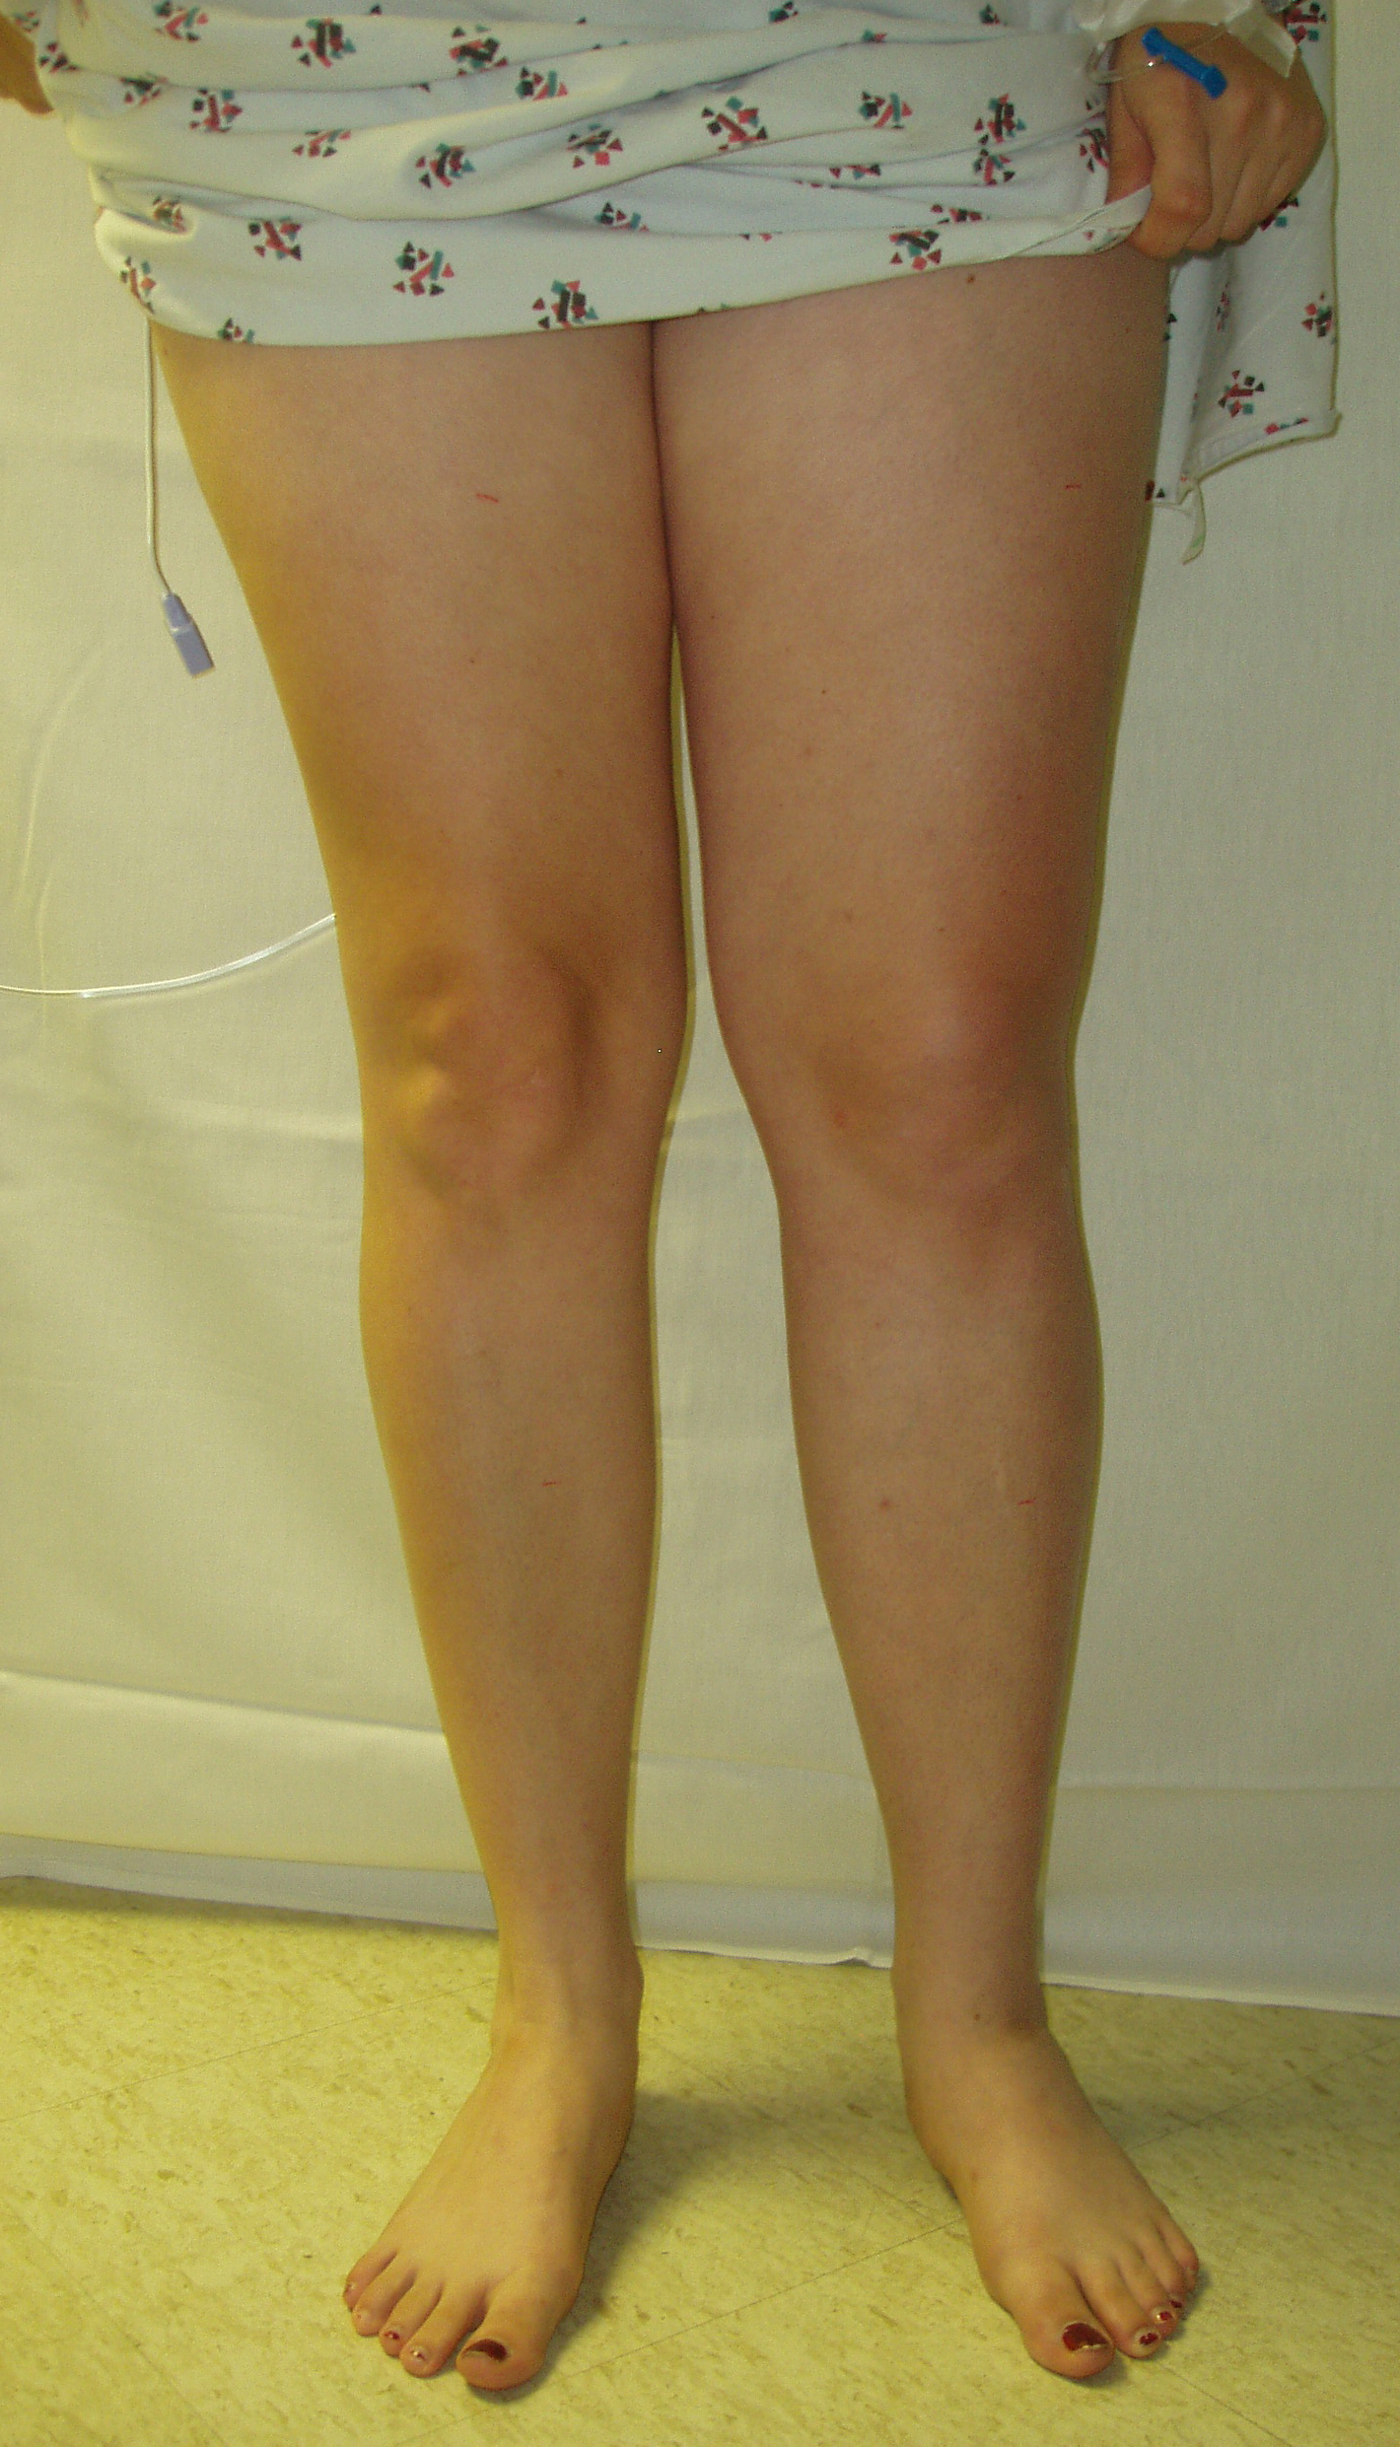

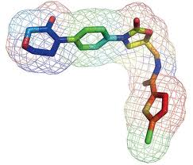
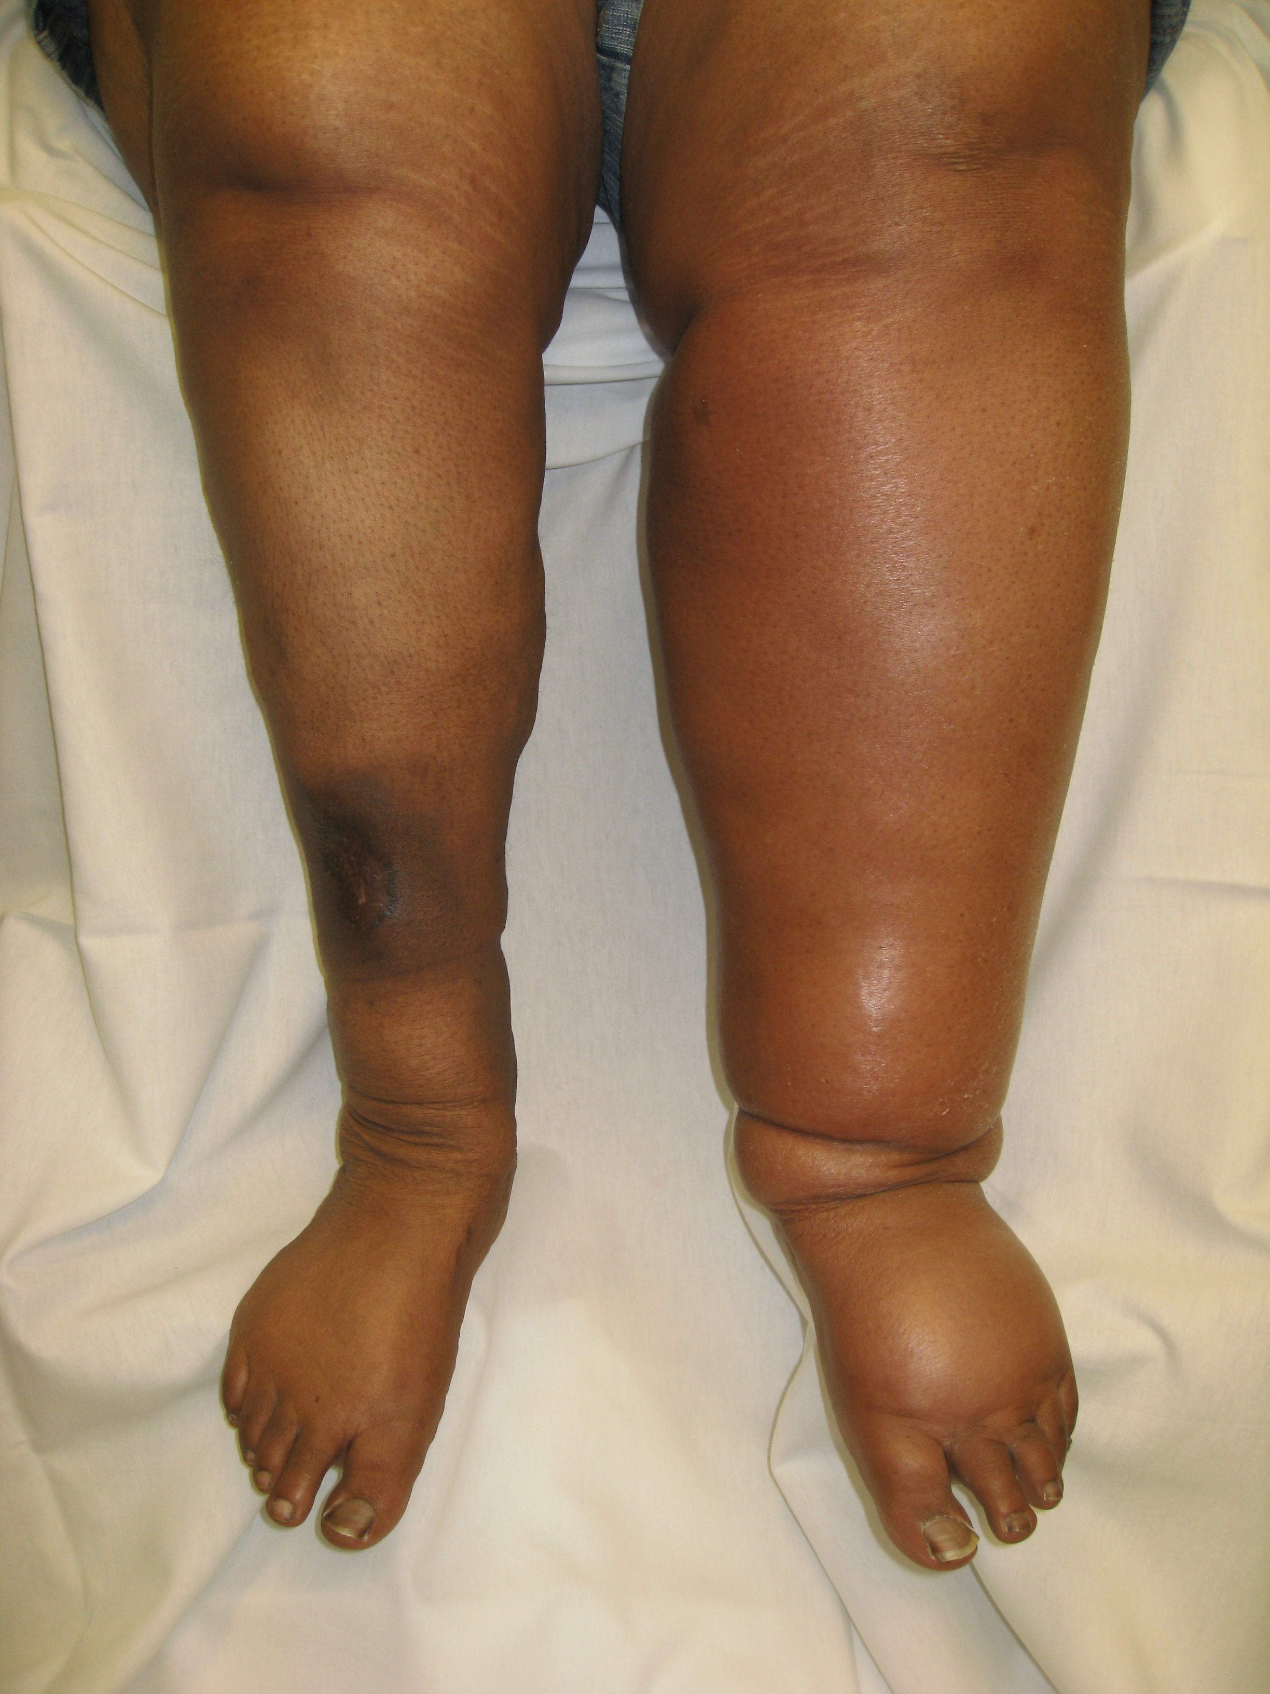
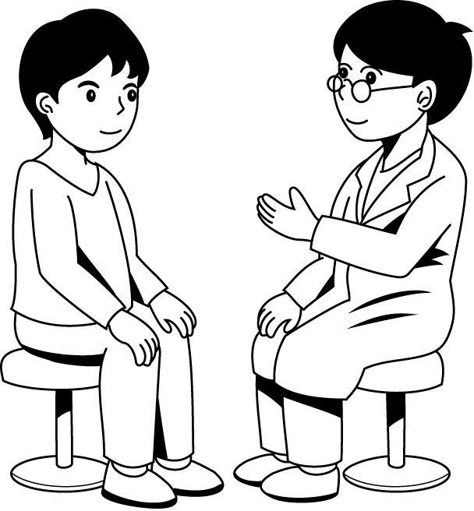
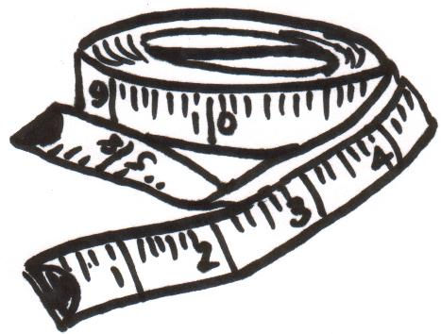

1
2
5
3
4
DVT, PE and Anticoagulants:
2014 Update
Stephan Moll, MD
University of North Carolina
Chapel Hill, NC
Raleigh, TIPS
Sept 27th, 2014

Slide 2
Objectives
At the end of this session the participant will be able to…
… optimally manage patients with VTE

Slide 3
Disclosures
Consultant: Janssen, Boehringer-Ingelheim, Daiichi, CSL Behring
Speaker bureau: none

Slide 4
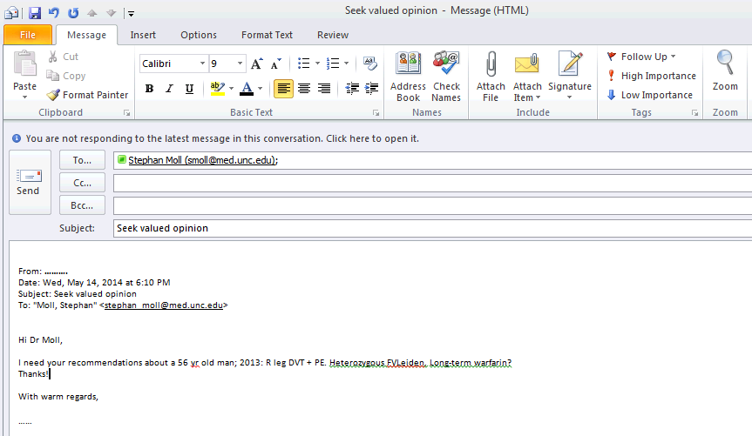

Slide 5

VTE: Length of Anticoagulation
Conglomerate decision of:
Risk of recurrent VTE (a)…., (b)…., (c) …..
Risk for Bleeding (a)…., (b)…., (c) …..
Patient preference
Warfarin “Hate Factor”
0
Blood Thinner “Hate Factor”
10
Notes:
5

Slide 6
Patient’s Personal Preference
Warfarin “Hate Factor”
0
Blood Thinner “Dislike Factor”
10
Notes:
6

Slide 7
VTE History
Question!
Inpatient consult:
“Quick curbside: How long would you anticoagulate a 64 year old man with a basilic vein DVT after a phlebotomy stick?”

Slide 8
Arm Clots - Anatomy 101
Superficial Veins
Deep Veins
Subclavian vein
Brachial vein (a deep vein)
Axillary vein (a deep vein)
Axillary vein
Basilic vein
Cephalic vein
Brachial veins
Median cubital vein
Median cephalic vein
Cephalic vein
Median forearm vein
Basilic vein
Radial veins
Ulnar veins
[Kitchens CS. Blood 2011 Jan 6;117(1):39-44. Epub 2010 Oct 27]

Slide 9
VTE History
Question!
MD call:
“Quick curbside: Superficial clot in the right leg superficial femoral vein; not very symptomatic. My plan was to observe.”
Notes:
9

Slide 10
Leg Clots - Anatomy 101
Inferior vena cava (IVC)
Common iliac vein
Internal iliac vein
External iliac vein
Common femoral vein
Proximal veins
Greater saphenous vein (GSV)
Deep femoral vein
Femoral vein (formerly: Superficial femoral vein)
Popliteal vein
Gastrocnemius vein
Anterior tibial vein
Lesser saphenous vein (LSV)
(in back of calf; not shown on image)
Soleus vein
Distal veins
Peroneal vein
Posterior tibial vein
Superficial veins
Deep Veins

Slide 11
Imaging, Lab Testing
PE – History, Work-Up
3
4
5
6
7
8
9
10

Slide 12
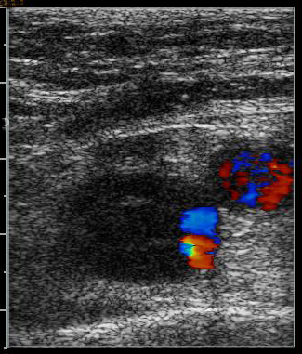
Doppler Ultrasound - Caveats
3
4
5
6
7
8
9
10
Caveats
“Acute” = acute or subacute (day to weeks to up to 3 months)
Dilated vein
“spongy” appearance
Non-hyperechoic intraluminal material
Diagnosing recurrent DVT
Decision is conglomerate of new clinical symptoms, DD, Doppler US
[Bates SM.ACCP guidelines, Chest 2012;141:351S-418S]

Slide 13
CTA Scan Caveats
3
4
5
6
7
8
9
10
Caveats
If CTA results do NOT match pre-test clinical assessment: CTA is wrong in ca. 50 % of cases
[Stein P. NEJM 2006;354:2317-27]
Review CTA with best radiologist
CTA is insensitive to detect chronic PE;
VQ scan is test of choice

Slide 14
Patient
Diagnosis
few days later
3 mo
any time
Q1:
Outpatient
or inpatient?

Slide 15

Outpatient vs. Inpatient
Take home point
DVT: Patient can walk into clinic/ED ➔ pt can walk out of it.
PE: Suitable for, may be, 50 % of pts.

Slide 16
Patient
Diagnosis
few days later
3 mo
any time
Q1:
Outpatient
or inpatient?
Q2:
Thrombolytics?

Slide 17
PE: Indicators of Poor Outcome
ESC criteria (based on consensus; lack of validation)
 | Criteria | mortality
High risk | Cardiovascular shock or persistent ⬇ BP | > 30 %
Intermediate risk | Lab (troponin, BNP)  or RV dysfunction | 1-30 %
Low risk | nl labs (troponin, BNP); nl RV function | < 1 %
“massive PE”
“sub-massive PE”
“low-risk PE”
[Torbicki A et al. Eur Heart J 2008;2276-315]
[Jaff MR et al. Circulation 2011;123:1788-830. AHA statement]
[Meyer G et al. NEJM 2014;370:1402-11]

Slide 18
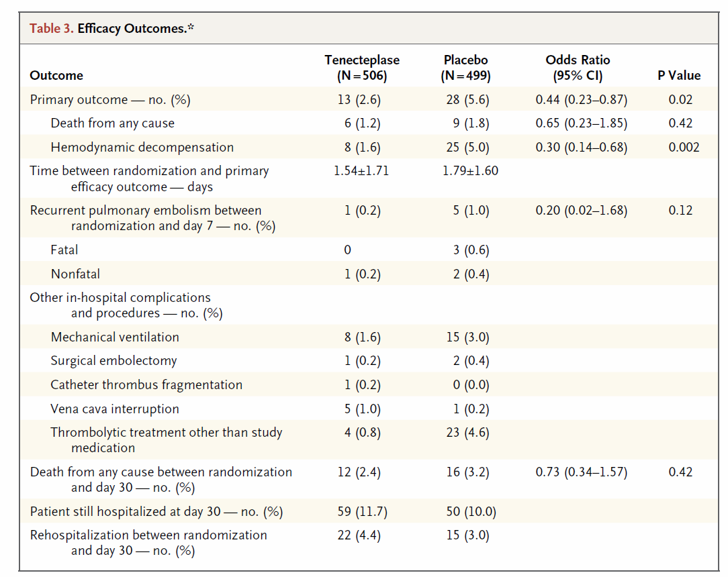

PE: Thrombolysis? – PEITHO trial
Pulmonary hypertension at 3 and 12 months?
[Meyer G et al. NEJM 2014;370:1402-11]
Notes:
Peitho is the goddess who personifies persuasion and seduction

Slide 19
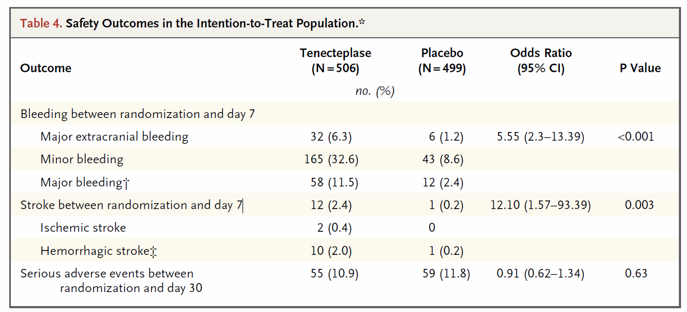
PE: Thrombolysis?
[Meyer G et al. NEJM 2014;370:1402-11]

Slide 20

Thrombolytics in DVT?
ATTRACT trial
666/692 patients enrolled as of Sept 24th, 2014.
[http://clinicaltrials.gov/ct2/show/NCT00790335?term=ATTRACT&rank=1]

Slide 21
Patient
Diagnosis
few days later
3 mo
any time
Q1:
Outpatient
or inpatient?
Q2:
Thrombolytics?
Q3:
LMWH/warfarin or NOAC?

Slide 22
New Oral Anticoagulants
NOAC = TSOAC = ODI
Non-vitamin K Oral Anticoagulants

Slide 23
New Oral Anticoagulants
[last updated: June 19th, 2014]

Slide 24
NOACs
 | Dabigatran | Rivaroxaban | Apixaban | Edoxaban
tmax | 1.5 - 3 hrs | 2 - 4 hrs | 1 - 3 hrs | 1 – 1.5 hrs
Half life | 12 – 14 hrs | 9 - 13 hrs | 8 – 15 hrs | 9 – 11 hrs
Renal excretion
Dosing in VTE
Acute VTE
[Yeh CH et al. Blood 2014;June12. Epub ahead of print]
[Eikelboom JW et al. Circulation;121:1523-1532]
[Perzborn E. Haemostaseologie 2009;29:260-267]

Slide 25
NOACs
 | Dabigatran | Rivaroxaban | Apixaban | Edoxaban
tmax | 1.5 - 3 hrs | 2 - 4 hrs | 1 - 3 hrs | 1 – 1.5 hrs
Half life | 12 – 14 hrs | 9 - 13 hrs | 8 – 15 hrs | 9 – 11 hrs
Renal excretion | 80% | 33 % | ca. 25 % | 35 %
Dosing in VTE
Acute VTE
[Yeh CH et al. Blood 2014;June12. Epub ahead of print]
[Eikelboom JW et al. Circulation;121:1523-1532]
[Perzborn E. Haemostaseologie 2009;29:260-267]

Slide 26
NOACs
 | Dabigatran | Rivaroxaban | Apixaban | Edoxaban
tmax | 1.5 - 3 hrs | 2 - 4 hrs | 1 - 3 hrs | 1 – 1.5 hrs
Half life | 12 – 14 hrs | 9 - 13 hrs | 8 – 15 hrs | 9 – 11 hrs
Renal excretion | 80% | 33 % | ca. 25 % | 35 %
Dosing in VTE | q 12 hrs | 1x / day | q 12 hrs | 1x / day
Acute VTE
[Yeh CH et al. Blood 2014;June12. Epub ahead of print]
[Eikelboom JW et al. Circulation;121:1523-1532]
[Perzborn E. Haemostaseologie 2009;29:260-267]

Slide 27
NOACs
 | Dabigatran | Rivaroxaban | Apixaban | Edoxaban
tmax | 1.5 - 3 hrs | 2 - 4 hrs | 1 - 3 hrs | 1 – 1.5 hrs
Half life | 12 – 14 hrs | 9 - 13 hrs | 8 – 15 hrs | 9 – 11 hrs
Renal excretion | 80% | 33 % | ca. 25 % | 35 %
Dosing in VTE | q 12 hrs | 1x / day | q 12 hrs | 1x / day
Acute VTE | Bridge with LMWH first | Give NOAC right off the bat | Give NOAC right off the bat | Bridge with LMWH first
[Yeh CH et al. Blood 2014;June12. Epub ahead of print]
[Eikelboom JW et al. Circulation;121:1523-1532]
[Perzborn E. Haemostaseologie 2009;29:260-267]

Slide 28

NOAC and VTE
In which patient do I consider a NOAC?
Acute DVT or PE
All VTE patients treated as outpatients
Mild to moderate VTE
On long-term warfarin
I discuss it with all patients
Fluctuating INRs, high “warfarin hate factor”
Notes:
28

Slide 29
NOAC and VTE
In which patient do I NOT use a NOAC
Renal impairment: GFR < 30 ml/min (or 40; “buffer zone”)
Notes:
29
(140-age) x kg / serum creatinine x 0.85 for women

Slide 30
NOAC and VTE
In which patient do I NOT use a NOAC
Renal impairment: GFR < 30 ml/min (or 40; “buffer zone”)
Liver disease
Increased bleeding risk
BMI > 40 or “low” body weight
Notes:
30
(140-age) x kg / serum creatinine x 0.85 for women

Slide 31
NOAC and VTE
In which patient do I NOT use a NOAC
Renal impairment: GFR < 30 ml/min (or 40; “buffer zone”)
Liver disease
Increased bleeding risk
BMI > 40 or “low” body weight
Cancer
Patient who doesn’t like idea of “no known reversal agent/strategy”.
Sick inpatient
Notes:
31
(140-age) x kg / serum creatinine x 0.85 for women

Slide 32

NOAC and VTE
Things to consider when starting a NOAC
Baseline Labs: CBC, creatinine, AST, ALT, t. bili
GFR > 30 ml/min
Check with insurance carrier (ca. $ 330 / month)
Rivaroxaban: 15 mg bid for 3 weeks, then 20 mg once daily
Apixaban: acute VTE: 10 mg bid x 1 wk; then 5 mg bid secondary prevention: 2.5 mg bid
Dabigatran: 150 mg bid
[personal communications: evaluation of Average Wholesale Price (AWP) and inquiry from 2 national pharmacy chains; Jan 13, 2014]
Notes:
32

Slide 33
New Oral Anticoagulants: Cost
Per day: $ 9.90 to $ 12.00 (ca. $ 11.00 /day)
Per month: $ 297.00 to 362.00 (ca. $ 330.00 /mo)
[personal communications: evaluation of Average Wholesale Price (AWP) and
inquiry from 2 national pharmacy chains (CVS, Rite-Aid); Jan 13, 2014]
Notes:
33
Qty
AWP *
CVS
Walgreens
Walmart
Apixaban 5 mg bid
60
$300.44
$335.99
$308.99
$276.16
Rivaroxaban 20 mg qd
30
$300.42
$335.99
$324.99
$281.46
Dabigatran 150 mg bid
60
$300.44
$330.99
$303.99
$286.32

Slide 34
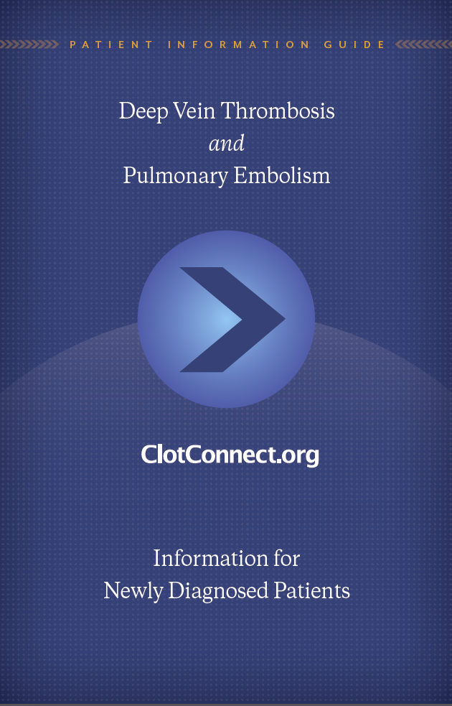
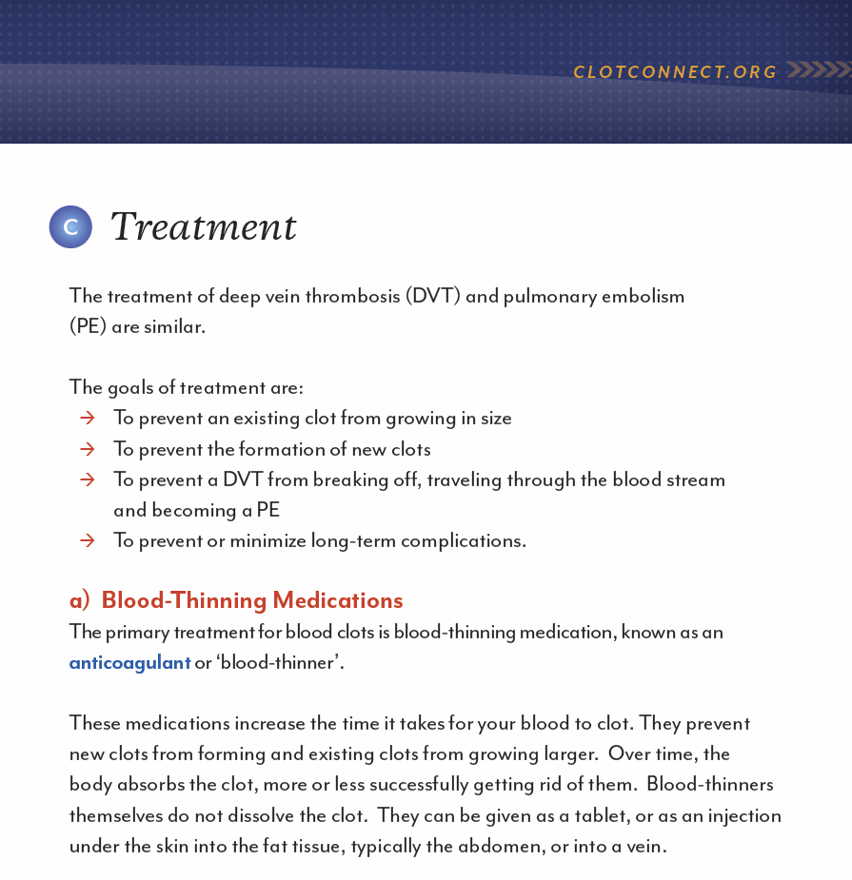
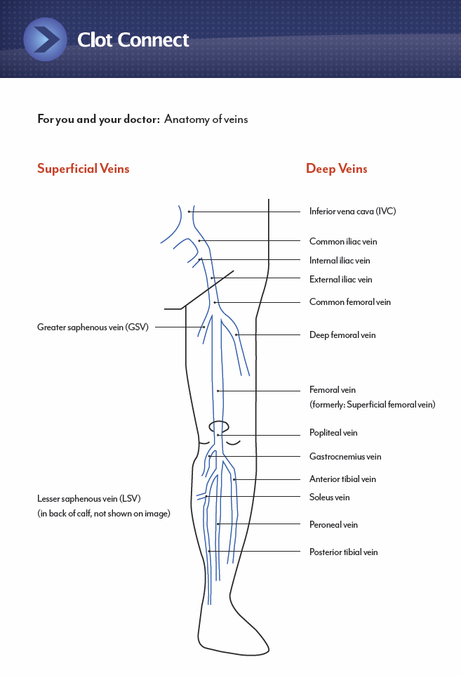
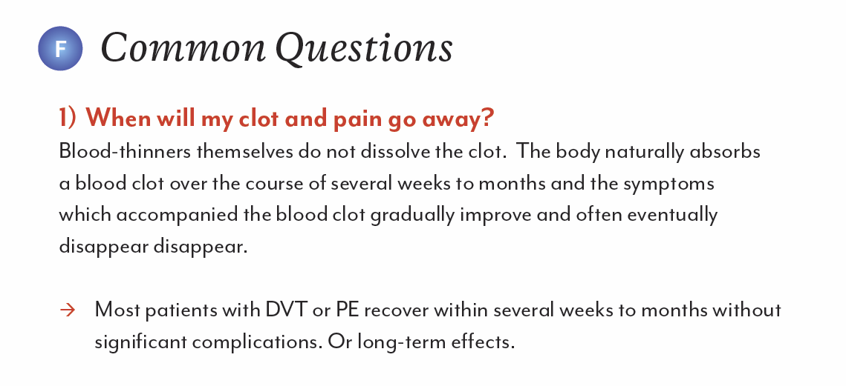
VTE Brochure
[http://files.www.clotconnect.org/DVT_and_PE.pdf]

Slide 35
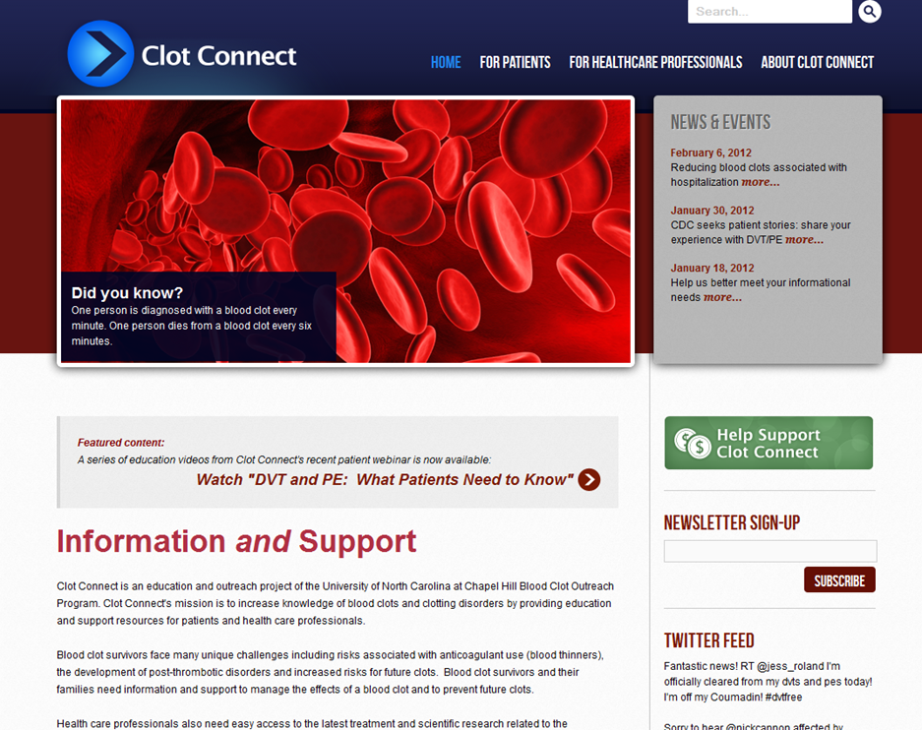

Slide 36
Patient
Diagnosis
few days later
3 mo
any time
Q1:
Outpatient
or inpatient?
Q4:
Compression stockings?
Q2:
Thrombolytics?
Q3:
LMWH/warfarin or NOAC?

Slide 37

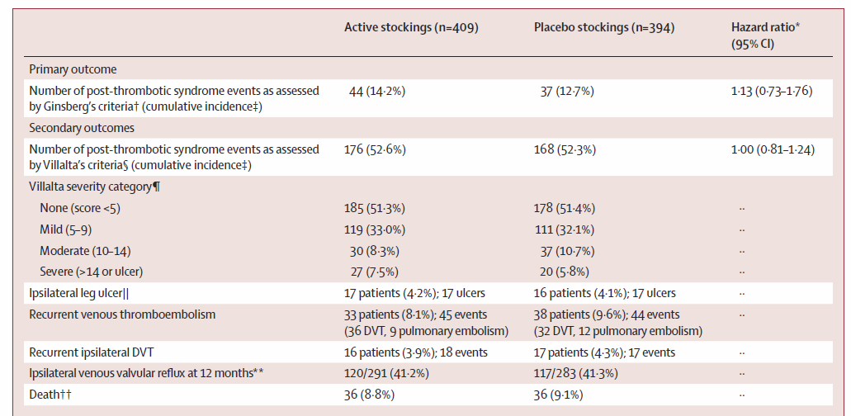
Stockings? SOX Trial
[Kahn S et al. Lancet Dec 6, 2013; pre-published on the web]
Conclusion: Compression stockings did not prevent PTS
Take home point
Don’t MAKE patients wear compression stockings, but offer them.

Slide 38
Patient
Diagnosis
few days later
3 mo
any time
Q1:
Outpatient
or inpatient?
Q4:
Compression stockings?
Q5:
D/c anticoag or long-term?
Q2:
Thrombolytics?
Q3:
LMWH/warfarin or NOAC?

Slide 39
How Long To Treat With Anticoagulation?
VTE due to major transient risk factor
3 months
Woman with VTE on hormones
Non-major transient risk factor
Strong Thrombophilia
Woman with unprovoked VTE
- D-dimer +
DVT
PE
Man, unprovoked VTE
Long-term
DVT
PE
Other considerations: Bleeding, fluctuating INRs, lifestyle impact, patient preference (Warfarin “Hate Factor”)
Notes:
UNC’s D-dimer test: Hemosil D-dimer HS (IL)
Case fatality: 3.6 % for recurrent VTE; 11.3 % for major bleed o VKA [Keron C, Akl EA. Blood 2014, ref 26]. There is uncertainty abut these estimates, as (a) case fatality for major bleeding is based on data from initial rather than extended therapy, and (b) recurrence is 3x as likely to be a PE if the initial event was a PE rather than a DVT and, thus, case fatality for recurrent VTE may be substantially higher when the initial VTE was a PE [Keron C, Akl EA. Blood 2014].

Slide 40
Patient
Diagnosis
few days later
3 mo
any time
Q1:
Outpatient
or inpatient?
Q4:
Compression stockings?
Q5:
D/c anticoag or long-term?
Q7:
Surgery
Q2:
Thrombolytics?
Q6:
ASA?
Q3:
LMWH/warfarin or NOAC?

Slide 41
When to d/c at Times of Surgery
Take home point
For all new oral anticoagulants, for d/c before surgery:
24-36 hrs for standard risk surgery.
2-4 d for high risk.
Consider renal fx.
Notes:
41

Slide 42
When to d/c at Times of Surgery
[Moll S, Francart S, Hawes S. manuscript in preparation]
Notes:
42
[van Ryn J et al. Thromb Haemost 2010;103:116-1127]

Slide 43
Contraceptive Options in Thrombosis / Thrombophilia
Estrogen combination pill
3rd generation
2nd generation
Norelgestromin & ethinyl estradiol
Etonogestrel & estradiol ring
Drospirenone & ethinyl estradiol (Yasmin®, Yaz®, Angeliq ®, etc.)
Progestin-only
Depo-Provera ®
Minipill
Implanon® rod
1
Mirena® IUD; Skyla® IUD
Non-hormonal methods
1. Weiss G. Am J Obstet Gynecol. 1999;180:S295-S301.
2. Rosendaal FR, et al. Thromb Haemost. 2001;6:112-23.
3. Conard J, et al. Contraception. 2004;70:437-441.
4. Bergendal A, et al. Acta Obstet Gynecol Scand. 2009;88:261-266.
5. Barsoum M et al. Thromb Res 2010;126:373-8.
6. Van Hylkama-Vlieg A et al. Arterioscler Thromb Vasc Biol 2010;30:2297-300.
7. Mantha S et al. BMJ 2012;Aug 7;345:34944.

Slide 44
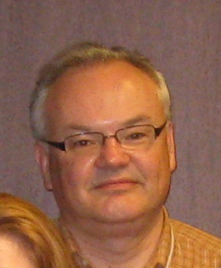
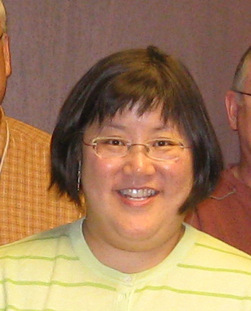
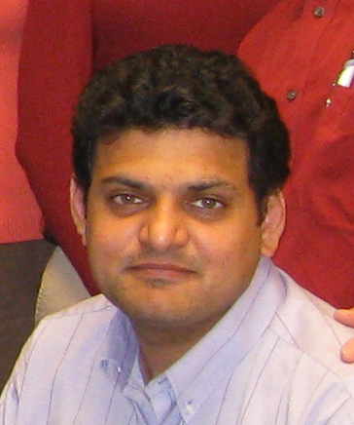
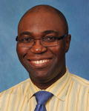
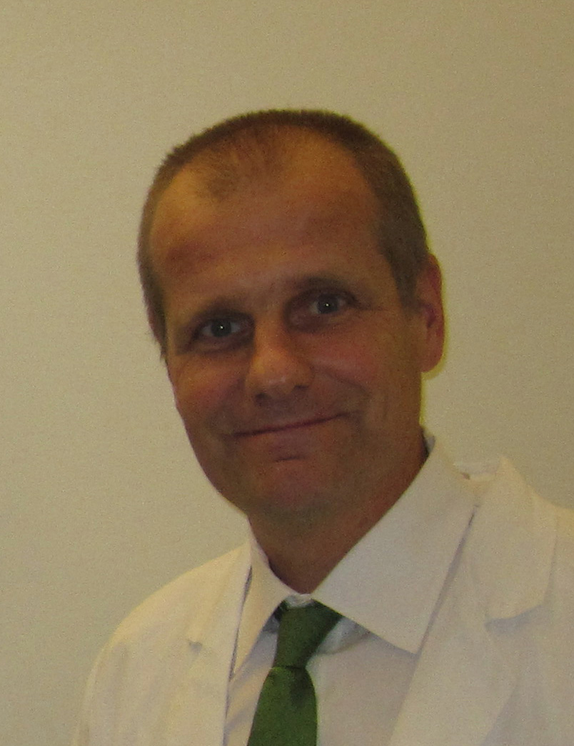
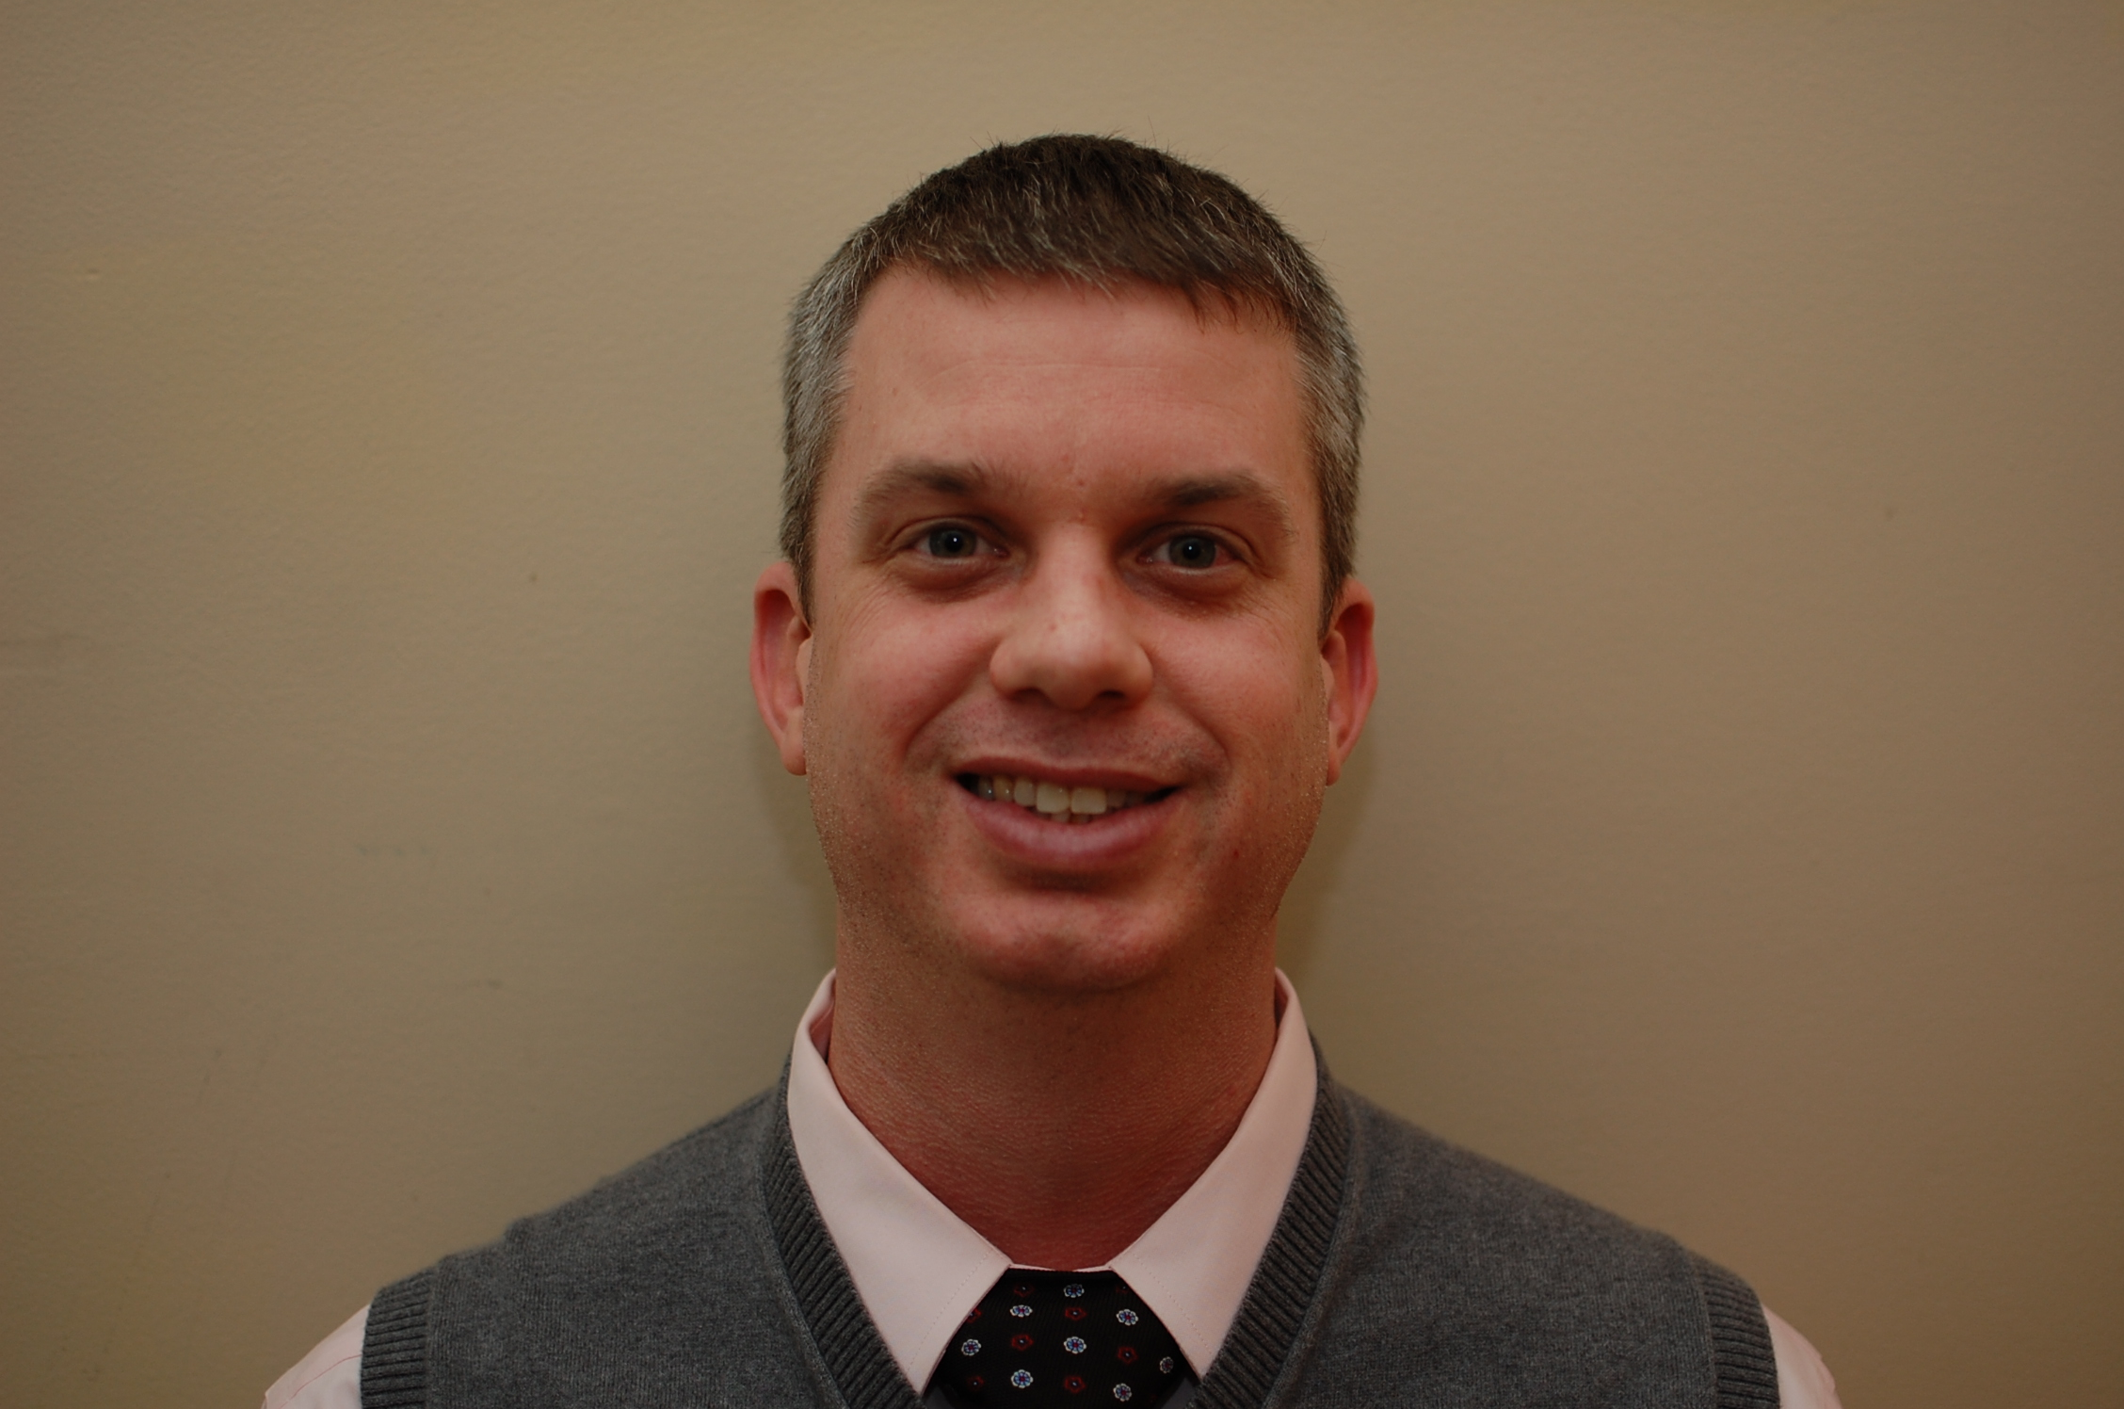


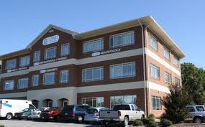
Hematology
Nigel Key
Alice Ma
Raj Kasthuri
Ken Ataga
Stephan Moll
Micah Mooberry
Tyler Buckner
Inpatient coagulation consult service
Outpatient Thrombosis Clinic (843-9084; James Malley)
Main outpatient heme nurse: Jori Thomas, 490-1325
[photo courtesy of Beth Waldron]

Slide 45

Questions?
Comments?

Slide 46
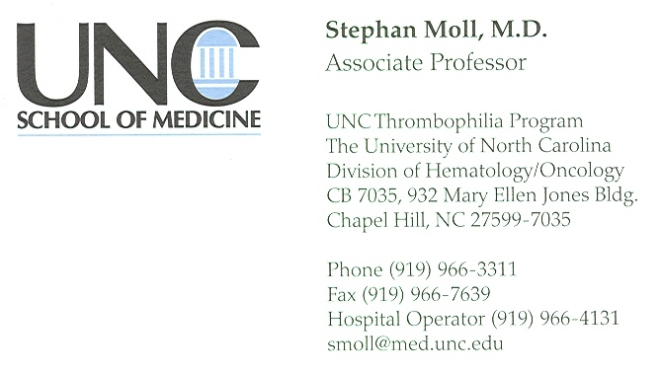

Slide 47

Safety

Slide 48

Patient
“How would you treat her?”
LMWH, UFH or fondaparinux + warfarin
Rivaroxaban (Xarelto)
Dabigatran (Pradaxa)
Apixaban (Eliquis)
CBC normal; creatinine 0.95; liver enzymes normal.

Slide 49
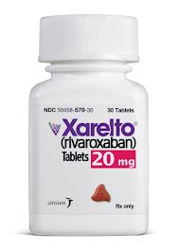
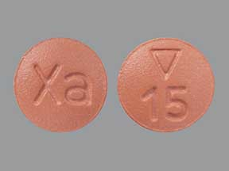
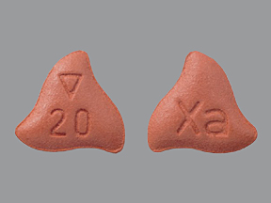
Rivaroxaban
15 mg bid
first 3 wks
20 mg qd
1. VTE Treatment
GFR > 30 mL/min
GFR
> 50
20 mg qd
2. A. Fib
GFR 15-50
15 mg qd
3. VTE Prevention
10 mg qd
GFR > 30 mL/min
Notes:
49

Slide 50
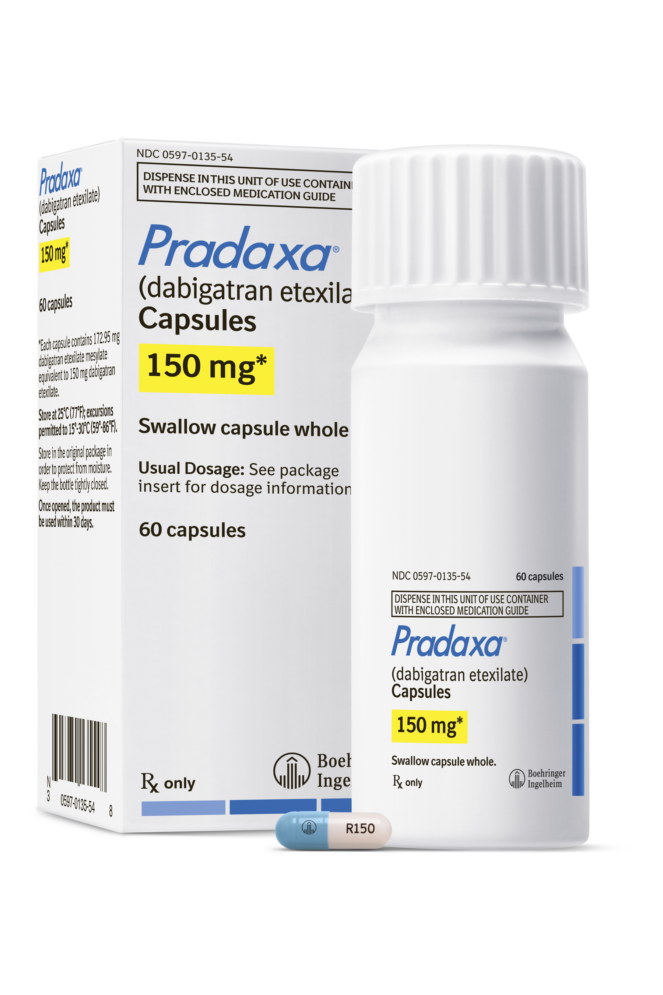
Dabigatran
1. VTE Treatment
FDA approved
150 mg bid
If GFR > 30 mL/min
FDA approved
2. A. Fib
150 mg bid
If GFR > 30 mL/min
75 mg bid
If GFR 15-30 mL/min
3. VTE prevention
Not FDA approved
Notes:
50

Slide 51
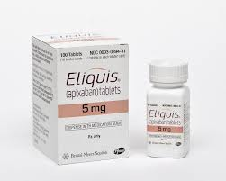
Apixaban
1. VTE Treatment
10 mg bid x 1 wk; then 5 mg bid
2.5 mg bid
FDA approved
FDA approved
2. A. Fib
5 mg bid
2.5 mg bid
If ≥ 2 criteria present:
≥ 80 years of age
Weight ≤ 60 kg
Creat ≥ 1.5 mg/dL
3. VTE prevention
FDA approved
2.5 mg bid
Notes:
51

Slide 52
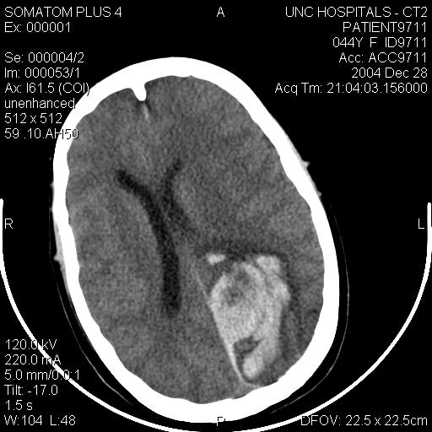
Patient
Diagnosis
few days later
3 mo
any time
Q1:
Outpatient
or inpatient?
Q4:
Compression stockings?
Q5:
D/c anticoag or long-term?
Q7:
Surgery
Q8:
Major bleed
Q2:
Thrombolytics?
Q6:
ASA?
Q3:
LMWH/warfarin or NOAC?

Slide 53
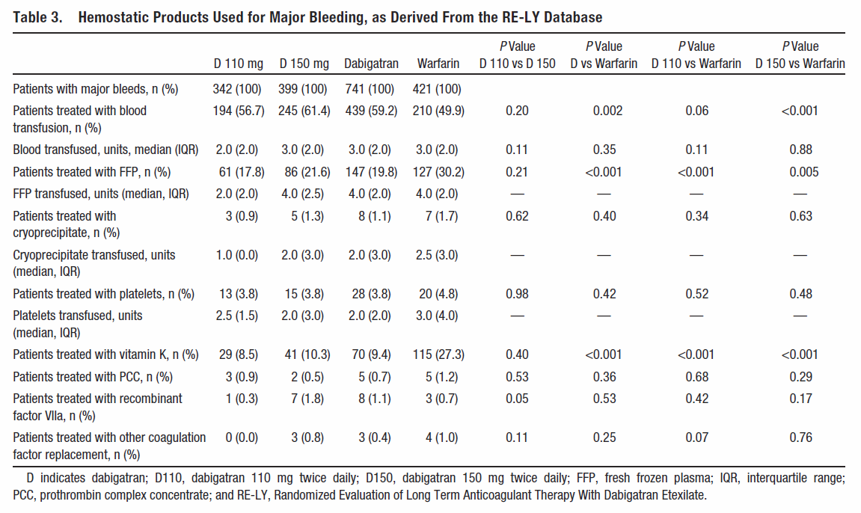
Major Bleeding on Dabigatran
[Majeed A et al. Circulation. 2013 Nov 19;128(21):2325-32]
Notes:
53

Slide 54

Kcentra® Approval
April 2013 and Dec 2013
Major Bleeding on warfarin
[Sarode R et al. Circulation 2013;128:1234-1243]
2. Urgent Surgery on warfarin
[Refaai , MA e al. ASH 2013, abstract 3588]
Notes:
Zhou 2013 article: rivaroxaban and collagen-induced mice brain injury: FFP, PCC, rVIIa were beneficial.

Slide 55
Kcentra® Approval
Take Home point
Warfarin and major bleeding: PCC (Kcentra®)
[Sarode R et al. Circulation 2013;128:1234-1243]
Notes:
Zhou 2013 article: rivaroxaban and collagen-induced mice brain injury: FFP, PCC, rVIIa were beneficial.

Slide 56

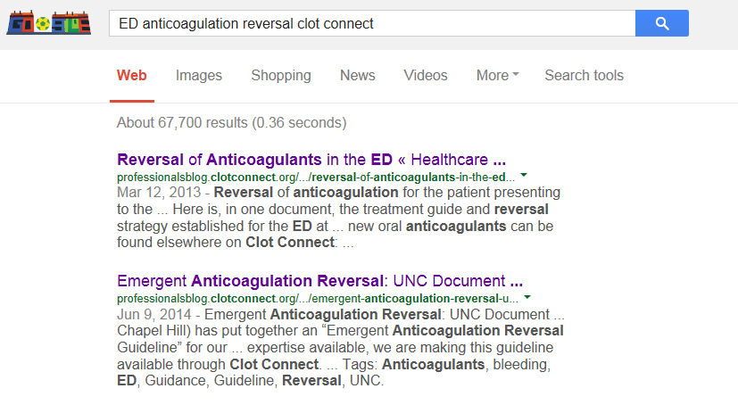
Bleeding on Warfarin
June 2014

Slide 57
Coagulation Testing

Slide 58

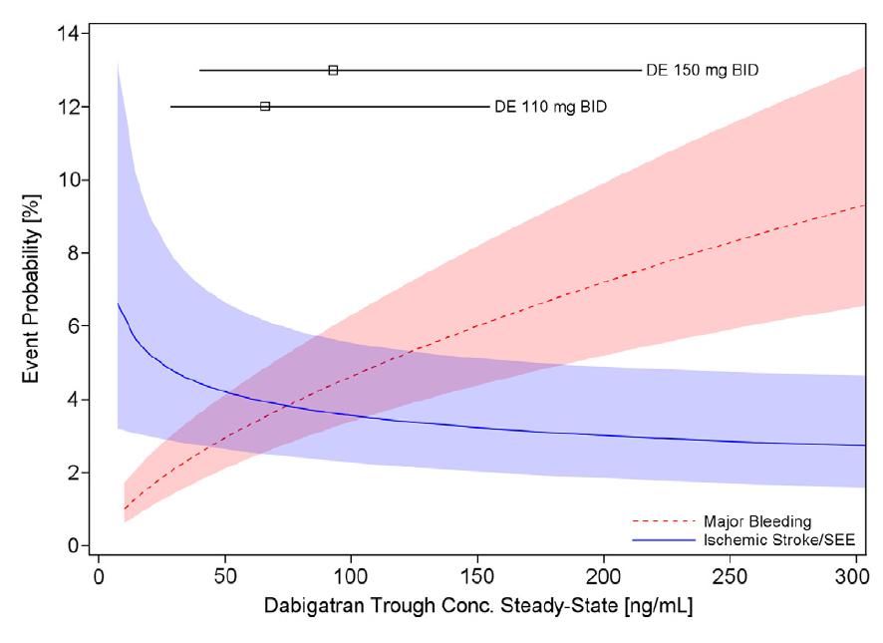
Dabigatran
Major bleeding -- ischemic stroke/systemic embolism
Mean: 91 ng.mL
10-90th percentile: 39.8-215 ng/mL
[Reilly PA et al. J Am Coll Cardiol 2014;63:321–8]
Notes:
58

Slide 59
Dabigatran
Major bleeding -- ischemic stroke/systemic embolism
Levels dependent on
Renal fx (Creat Cl 30-50 vs > 80: 2.29x ⬆
Age (68 % ⬆ age >75 vs < 65)
Weight 21 % ⬇ > 100 kg vs 50-100 kg
Female 30 % ⬆ > males
Pt with highest level (highest bleeding risk)
Women, age > 75, low body weight, ⬆ creat.
Pt with lowest level (highest failure rate)
Man, age < 65, overweight
Mean: 91 ng.mL
10-90th percentile: 39.8-215 ng/mL
[Reilley PA et al. J Am Coll Cardiol 2014;63:321–8]
Notes:
59

Slide 60
Outpatient vs. Inpatient?
“Acute DVT or PE: How to manage?”
Probably outpatient
Probably admit
[Zondag W et al. J Thromb Haemost 2011;9:1500-7]
[Zondag W et al. J Thromb Haemost 2013;11(4):686-92]

Slide 61
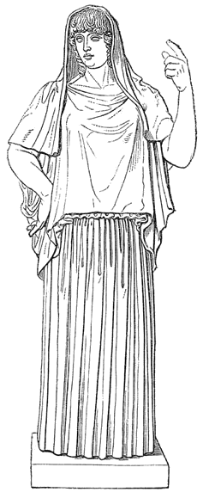
PE: Outpatient vs. Inpatient – HESTIA Criteria
1. Hemodynamically unstable?
2. Thrombolysis or embolectomy necessary?
3. Active bleeding or high risk of bleeding?
4. Oxygen needed to keep O₂ sat > 90 % for > 24 hrs?
5. PE dx’d during anticoagulant therapy?
6. iv pain medication for > 24 hrs?
7. Medical or social reason for admission?
8. GFR < 30 ml/min?
9. Severe liver impairment?
10. Pregnant?
11. Documented h/o HIT?
[Zondag W et al. J Thromb Haemost 2011;9:1500-7]
[Zondag W et al. J Thromb Haemost 2013;11(4):686-92]
Notes:
Hestia (Greek) = home and hearth. She is the goddess of the hearth, architecture, and the right ordering of domesticity, the family and the state.
2013 publication
We performed a cohort study with PE patients who were triaged with 11 criteria for outpatient treatment. Patients not eligible for outpatient treatment were treated in hospital. Study outcomes were recurrent venous thromboembolism, major bleeding and all-cause mortality during 3 months.
In total, 530 patients were included, of which 297 were treated at home. In the outpatient group, six patients (2.0%, 95% CI 0.7–4.3%) had recurrent venous thromboembolism versus nine in-patients (3.9%, 95% CI 1.9–7.0%). Three patients (1.0%, 95% CI 0.2–2.9) died during the 3-months follow-up in the outpatient group versus 22 patients (9.6%, 95% CI 6.3–14) in the in-patient group (p<0.05). None of the outpatients died as a result of fatal PE versus five (2.2%) in-patients (p<0.05). In the outpatient group, 0.7% (95% CI 0.08–2.4) had major bleeding events versus 4.8% (95% CI 2.4–8.4) of in-patients (p<0.05).
This study showed that the Hestia criteria can discriminate PE patients with low risk from patients with high risk for adverse clinical outcome. The low-risk patients can safely be treated at home.
2011 publication
A prospective cohort study of patients with objectively proven acute PE was conducted in 12 hospitals in The Netherlands between 2008 and 2010. Patients with acute PE were triaged with the predefined criteria for eligibility for outpatient treatment, with LMWH (nadroparin) followed by vitamin K antagonists. All patients eligible for outpatient treatment were sent home either immediately or within 24 h after PE was objectively diagnosed. Outpatient treatment was evaluated with respect to recurrent venous thromboembolism (VTE), including PE or deep vein thrombosis (DVT), major hemorrhage and total mortality during 3 months of follow-up.
RESULTS:
Of 297 included patients, who all completed the follow-up, six (2.0%; 95% confidence interval [CI] 0.8-4.3) had recurrent VTE (five PE [1.7%] and one DVT [0.3%]). Three patients (1.0%, 95% CI 0.2-2.9) died during the 3 months of follow-up, none of fatal PE. Two patients had a major bleeding event, one of which was fatal intracranial bleeding (0.7%, 95% CI 0.08-2.4).
CONCLUSION:
Patients with PE selected for outpatient treatment with predefined criteria can be treated with anticoagulants on an outpatient basis.

Slide 62
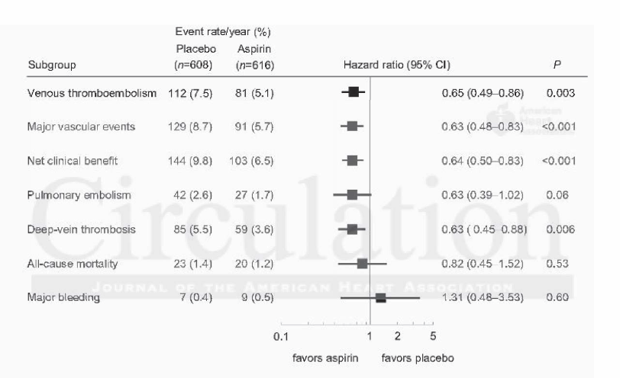
Aspirin and VTE
Simes J et al. Circulation 2014 Aug 25 [Epub ahead of print].
Notes:
62

